Slide 1
From Output to Outcome
- Agile2018 Report -
Hiroyuki Ito

Slide 2
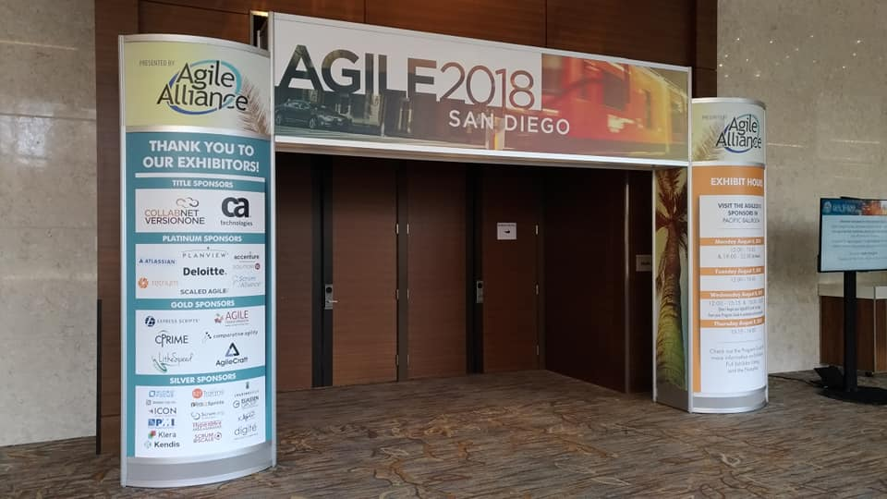
Open Your Gate

Slide 3




In San Diego, CA, USA

Slide 4
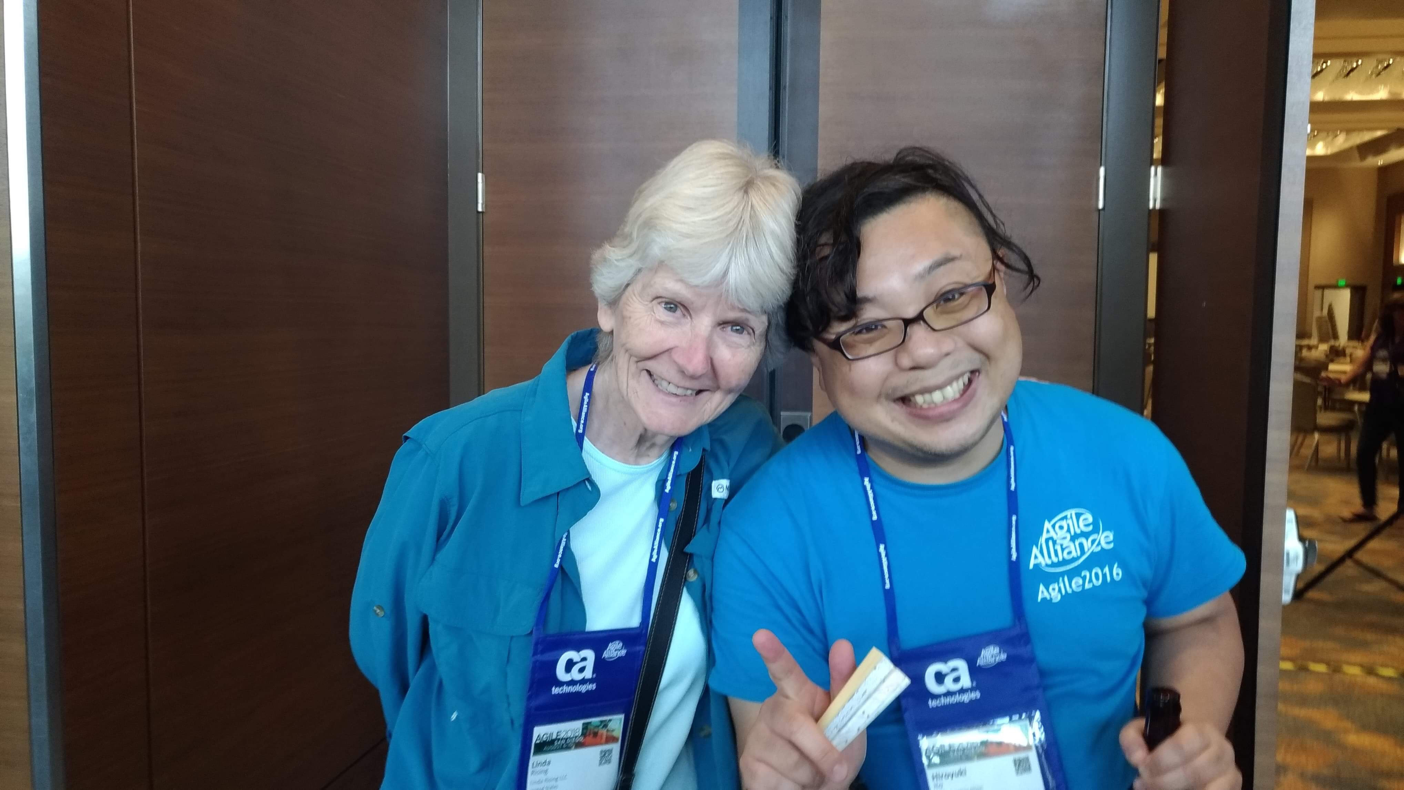
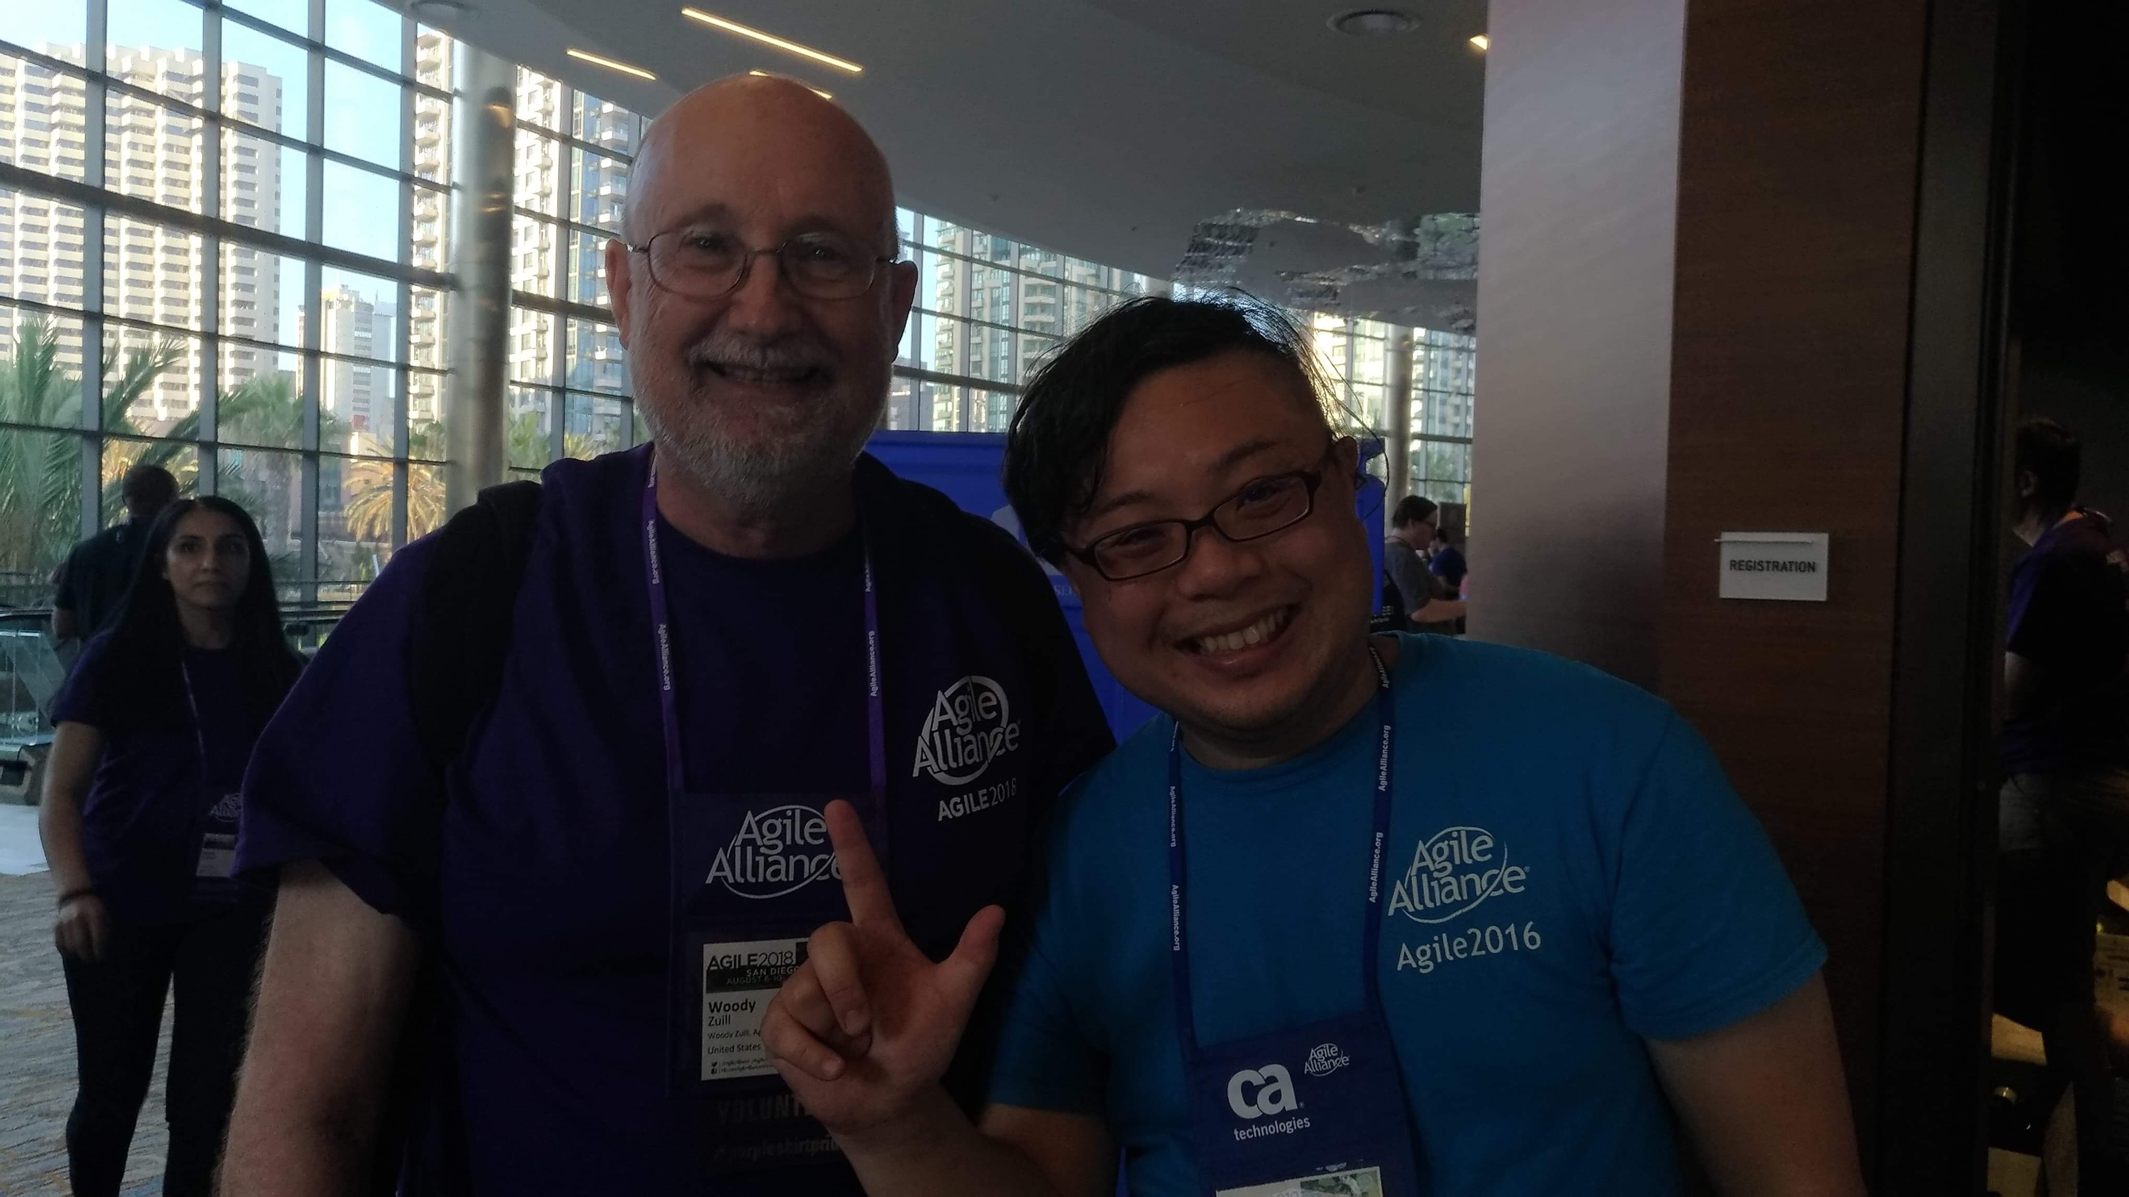
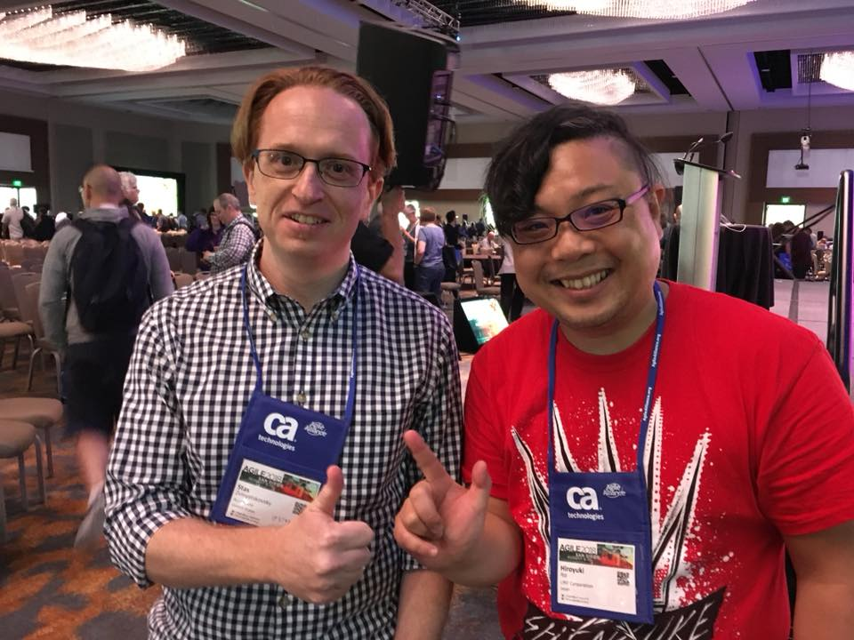
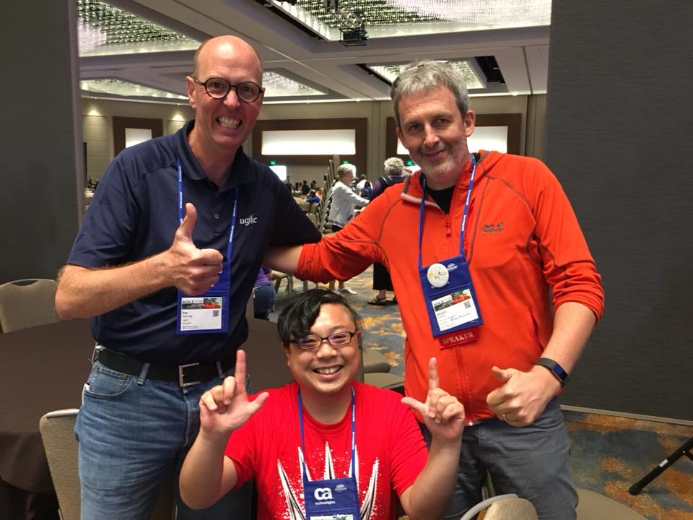
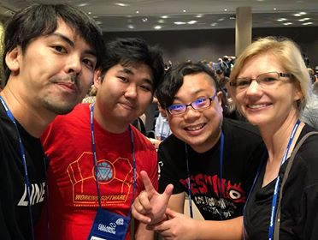
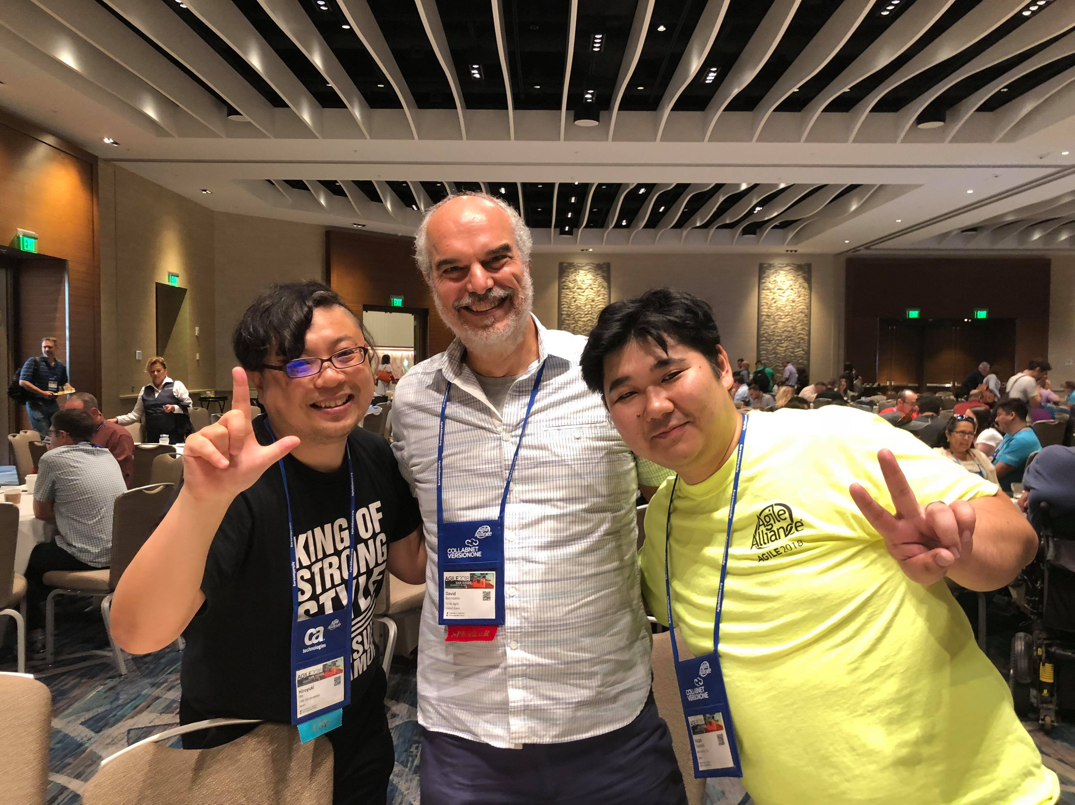
With Global Practitioners!

Slide 5
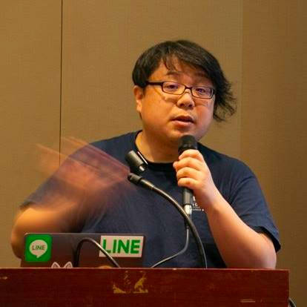


Hiroyuki Ito (The HIRO)
@hageyahhoo
The 1st SET at LINE Corp.
Keynote Speaker of DevOps Summit 2016 (TW)
Speaker of Agile2014

Slide 6
$ history
6 times attendee from Japan!
[Reports]
Agile2017 (JP)
Agile2016 (JP)
Agile2014 (EN)
Agile2013 (JP)
Agile2012 (JP)

Slide 7
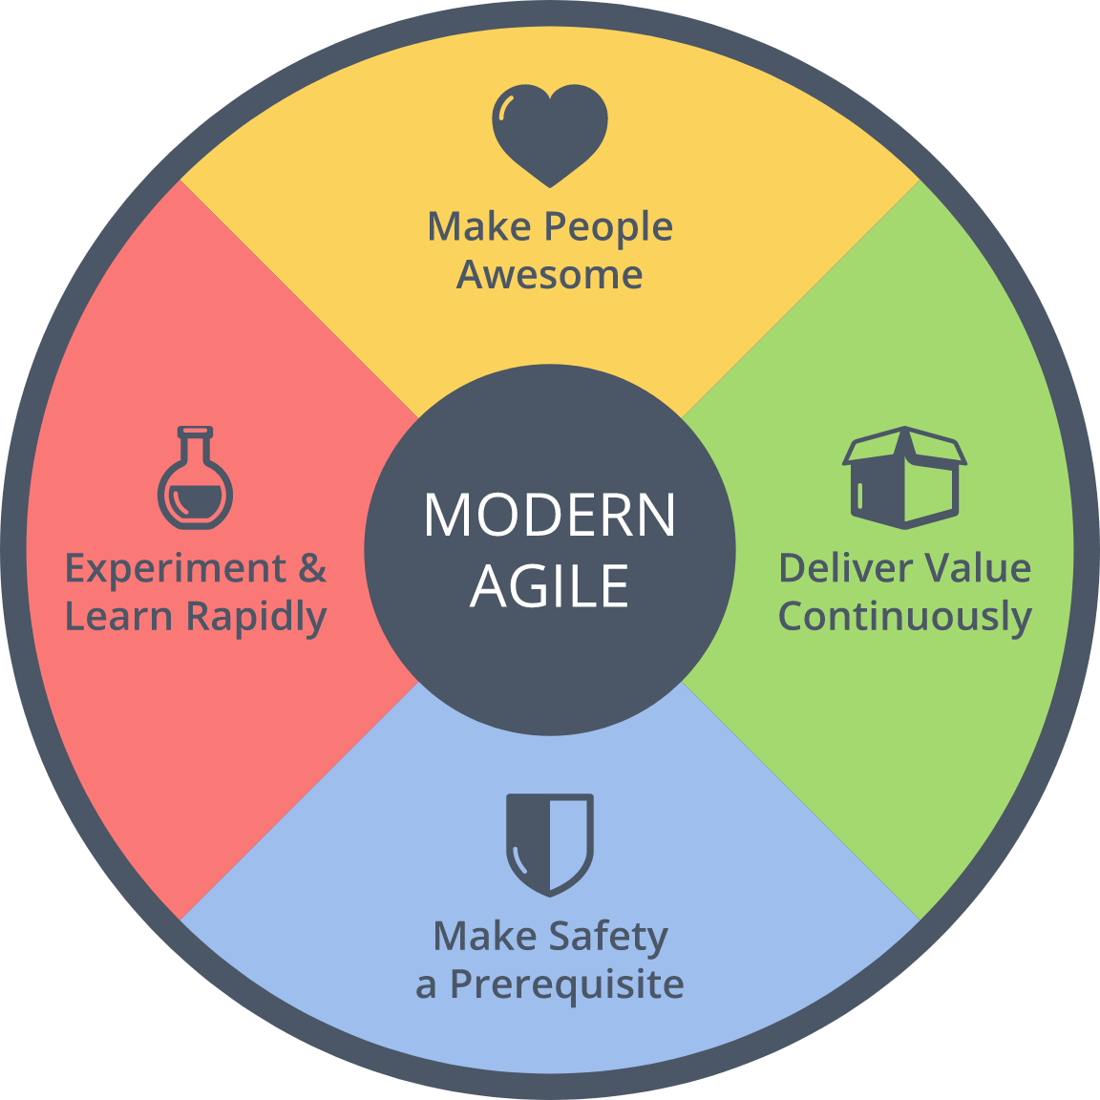
$ history
Achievements
2016 : Brought back
2014 : Speaker
Brought back Metrics
2013 : Speech at OpenJam

Slide 8
Agenda
1. Summary of Agile2018
2. Three Big Trends
3. Focus More on Outcome
4. Other Topics
5. Conclusion

Slide 9
1. Summary of Agile2018
2. Three Big Trends
3. Focus More on Outcome
4. Other Topics
5. Conclusion

Slide 10

What is Agile2018?
https://www.agilealliance.org/agile2018/
Annual global conference of Agile in USA
The biggest one of Agile
Held by Agile Alliance

Slide 11
Basic Information
Duration | Aug. 6th – 10th (5 days)
# of Sessions | 279 (+5 YoY)
# of Categories | 21 (±0 YOY)
# of Parallel On-going Sessions | 20 (+1 YoY)
# of Attendees | 2,500
Type of Sessions | Talk/Workshop
Level of Sessions | Learning/Practicing/ Advancing

Slide 12
Categories (2018)
Category | # | Category | #
Agile Companies | 16 | Keynotes | 3
Agile Data Metrics and Forecasting | 6 | Leadership | 21
Agile Foundations | 7 | Learning | 19
Agile Midway | 7 | Project Program & Portfolio Management | 18
Coaching & Mentoring | 21 | Testing & Quality | 12
Collaboration Culture & Teams | 24 | User Experience | 12
Customers & Products | 15 | Experience Reports | 24
Dev Practices and Craft | 17 | The Future of Agile Software Development (IEEE Software) | 8
DevOps | 12 | Audacious Salon | 14
Enterprise Agile | 20 | Stalwarts | 10

Slide 13
Categories (2018)
Category | # | Category | #
Agile Companies | 16 | Keynotes | 3
Agile Data Metrics and Forecasting | 6 | Leadership | 21
Agile Foundations | 7 | Learning | 19
Agile Midway | 7 | Project Program & Portfolio Management | 18
Coaching & Mentoring | 21 | Testing & Quality | 12
Collaboration Culture & Teams | 24 | User Experience | 12
Customers & Products | 15 | Experience Reports | 24
Dev Practices and Craft | 17 | The Future of Agile Software Development (IEEE Software) | 8
DevOps | 12 | Audacious Salon | 14
Enterprise Agile | 20 | Stalwarts | 10
Promoted as one category!

Slide 14
Categories (2018)
Category | # | Category | #
Agile Companies | 16 | Keynotes | 3
Agile Data Metrics and Forecasting | 6 | Leadership | 21
Agile Foundations | 7 | Learning | 19
Agile Midway | 7 | Project Program & Portfolio Management | 18
Coaching & Mentoring | 21 | Testing & Quality | 12
Collaboration Culture & Teams | 24 | User Experience | 12
Customers & Products | 15 | Experience Reports | 24
Dev Practices and Craft | 17 | The Future of Agile Software Development (IEEE Software) | 8
DevOps | 12 | Audacious Salon | 14
Enterprise Agile | 20 | Stalwarts | 10
Promoted as one category!
Decreasing. Maybe moved to deliver:Agile 2018

Slide 15
[FYI] Categories (2017)
Category | # | Category | #
Agile Alliance Lounge | 16 | Leadership | 21
Agile Companies | 13 | Learning | 17
Agile Foundations | 7 | Project Program & Portfolio Management | 21
Coaching & Mentoring | 17 | Testing & Quality | 12
Collaboration Culture & Teams | 24 | User Experience | 10
Customers & Products | 15 | Experience Reports | 24
Development Practices & Craftsmanship | 24 | The Future of Agile Software Development (IEEE Software) | 8
DevOps | 16 | Audacious Salon | 14
Enterprise Agile | 25 | Open Jam | 6
Keynotes | 3 | Stalwarts | 11

Slide 16
1. Summary of Agile2018
2. Three Big Trends
3. Focus More on Outcome
4. Other Topics
5. Conclusion

Slide 17
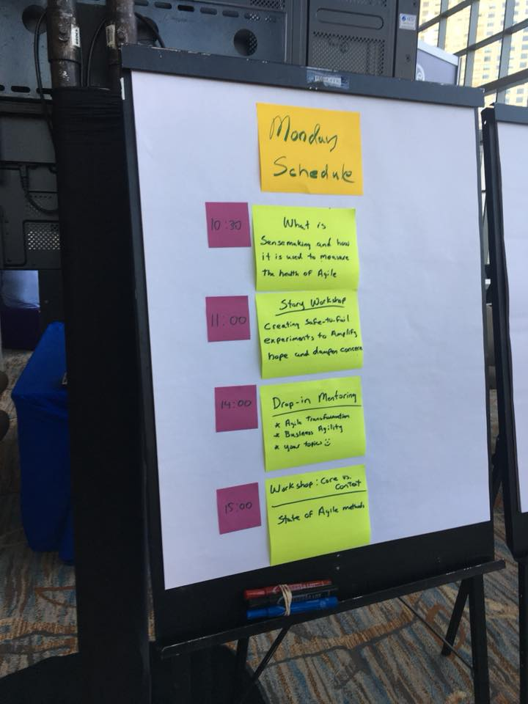
3 Big Trends of Agile2018
Scaling Agile
Business Agility
Technologies for Trial & Errors

Slide 18
1) Scaling Agile
2 definitions?
(Maybe) scaling development teams -> Remote teamと一緒で、割と当たり前感が強くない？？
From Development to Business (Including business persons to Agile)

Slide 19
2) Business Agility
Business Agility has not reached the pragmatic ideas yet.
Beyond IT
Utilize Agile to corporate level
Metrics as a tool for it
Focus more on Outcomeということをdeveloper他に示すという意味ではありかも

Slide 20
3) Tech for Trial & Errors
DevOps
Database DevOps
BizDevOps
DevSecOps
Continuous Delivery/Deployment
Utilizing them for
Make development easier
For outcome (business-focus)

Slide 21
Summary
Focus more on outcome is
The big trend behind them.

Slide 22
1. Summary of Agile2018
2. Three Big Trends
3. Focus More on Outcome
4. Other Topics
5. Conclusion

Slide 23
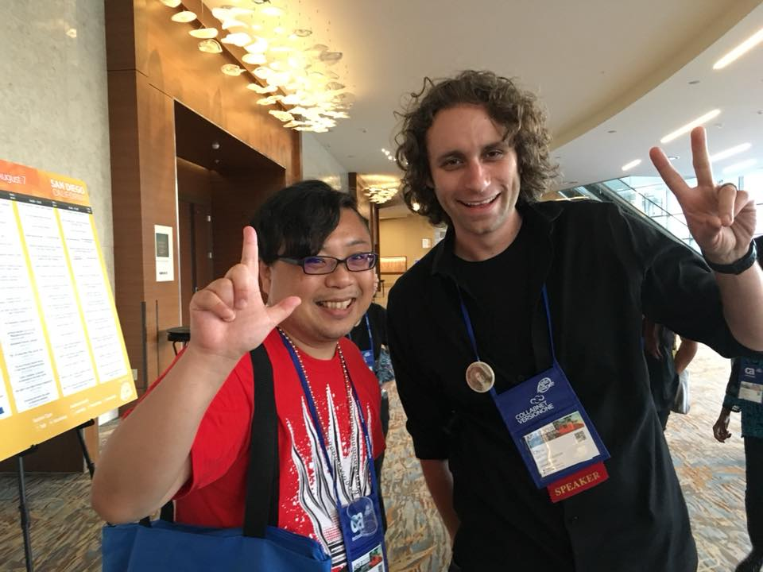
1) Technical Aspect
Continuous Delivery/Deployment
for outcome

Slide 24
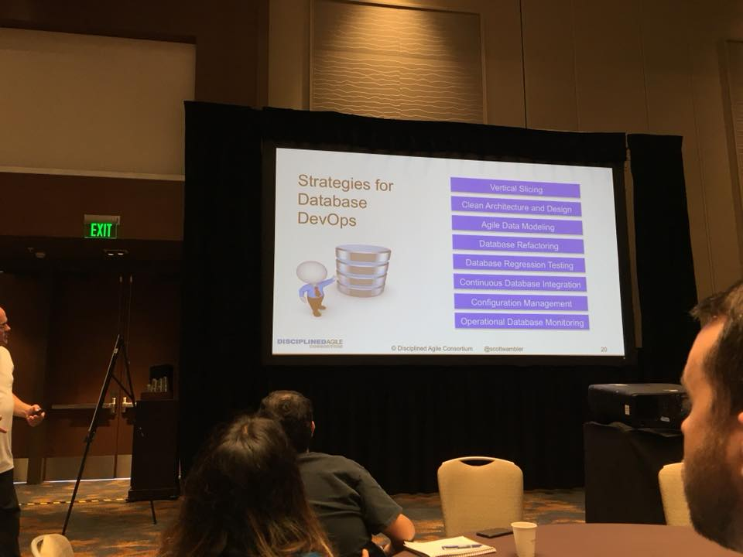
1) Technical Aspect
Database DevOps

Slide 25
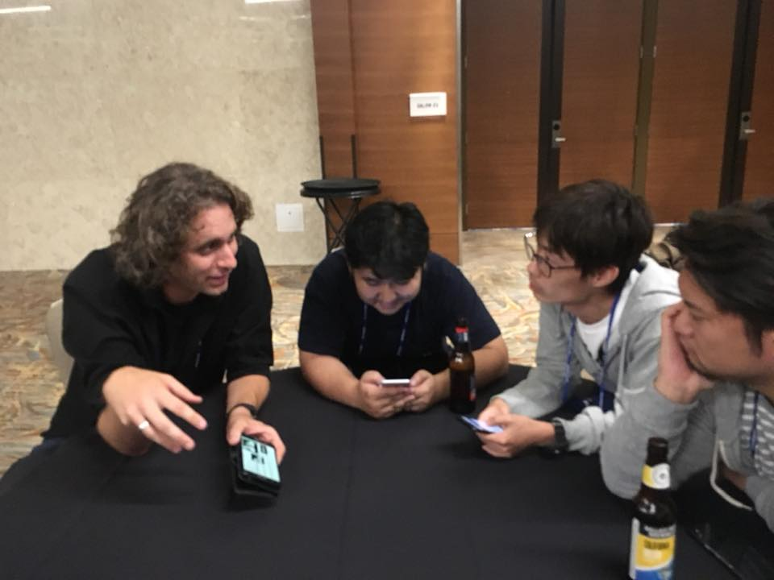
1) Technical Aspect
Mob Programming
Embrace Keybind

Slide 26
1) Technical Aspect
Technologies for Trial & Errors
Make experiment easier
DevOps to deliver values to markets quickly
Not only for technical interests
Tech/Process両側面で、心理的安全性をベースにbusinessにインパクトを！

Slide 27
2) Process Aspect
Metrics
Troy Magennis
何をどう測るか！？

Slide 28
2) Process Aspect
Mob Programming

Slide 29
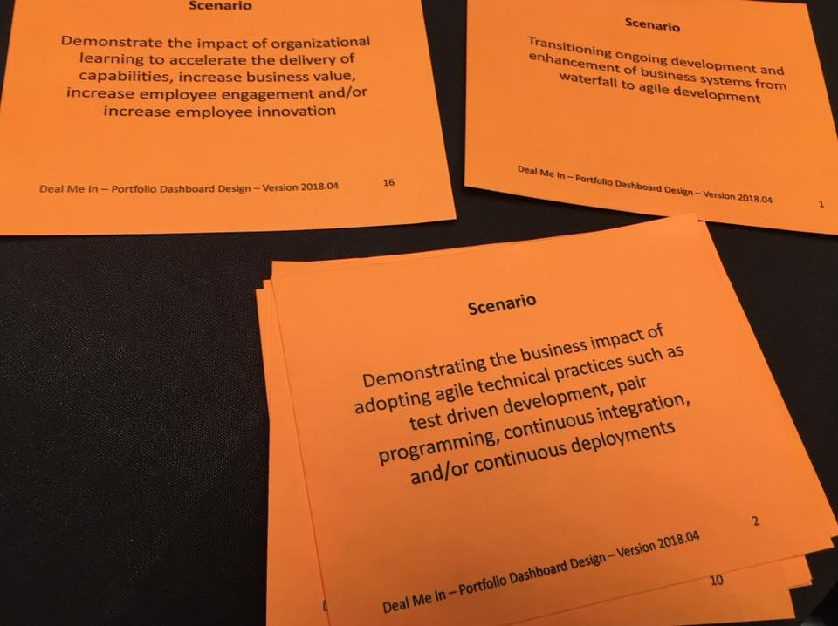
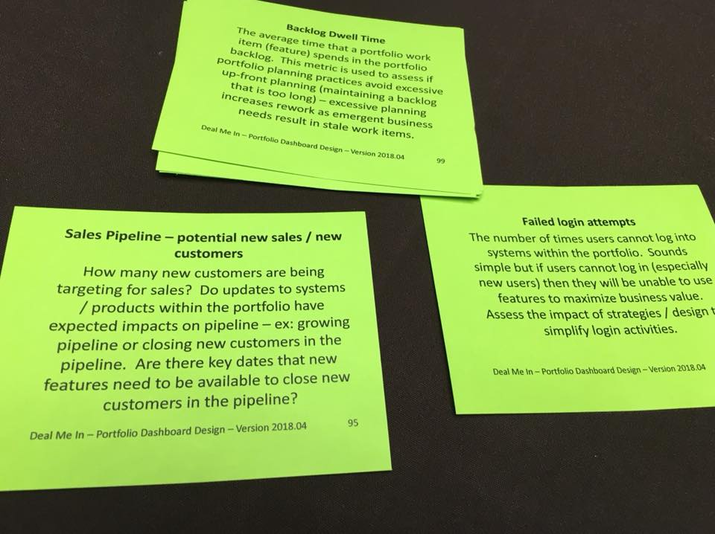
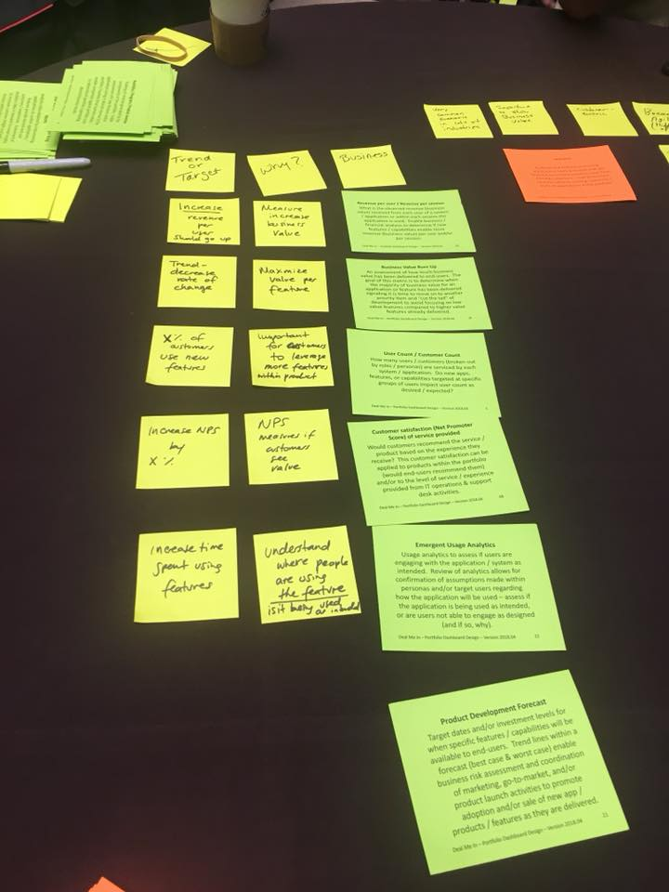
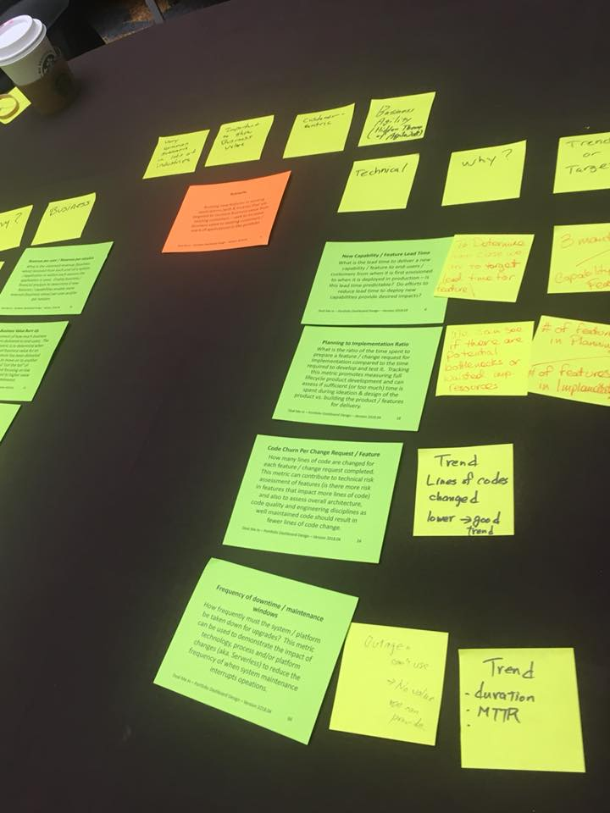
3) Tools
“Portfolio dashboard” & “metrics cards”
ファシリテーション用の道具を事前準備

Slide 30
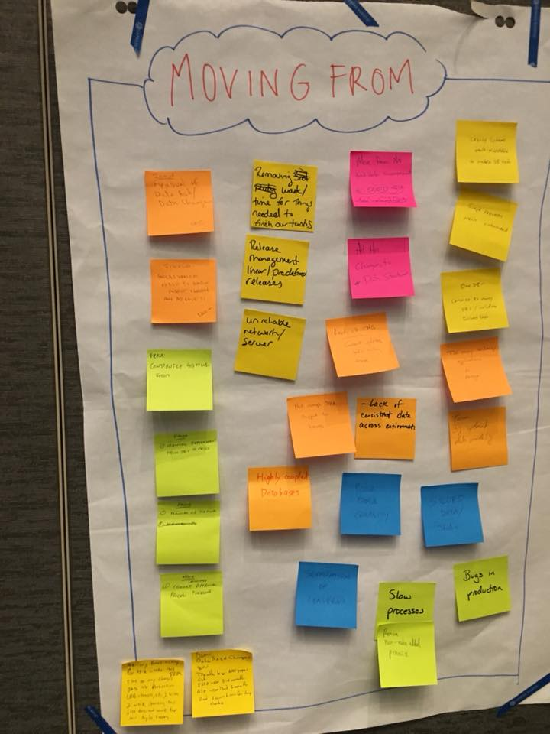
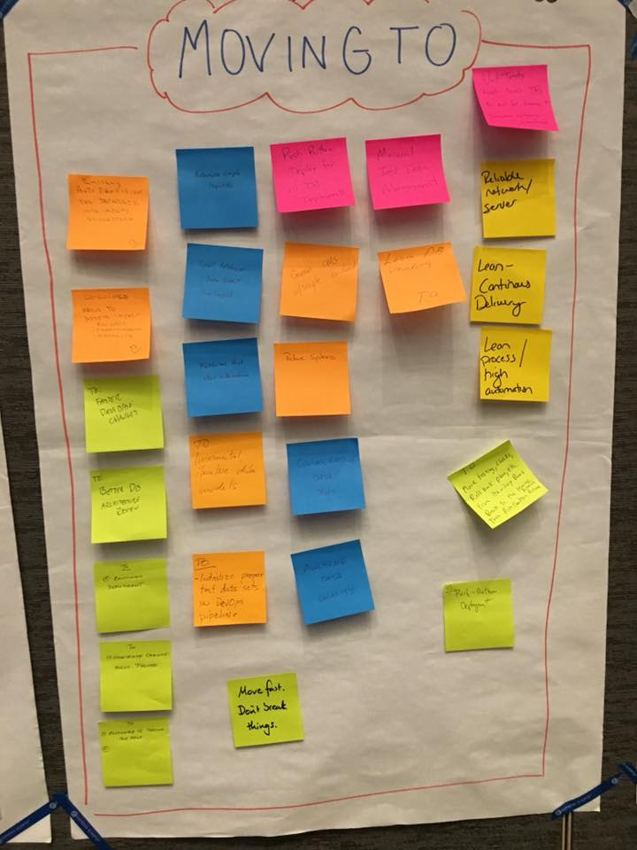
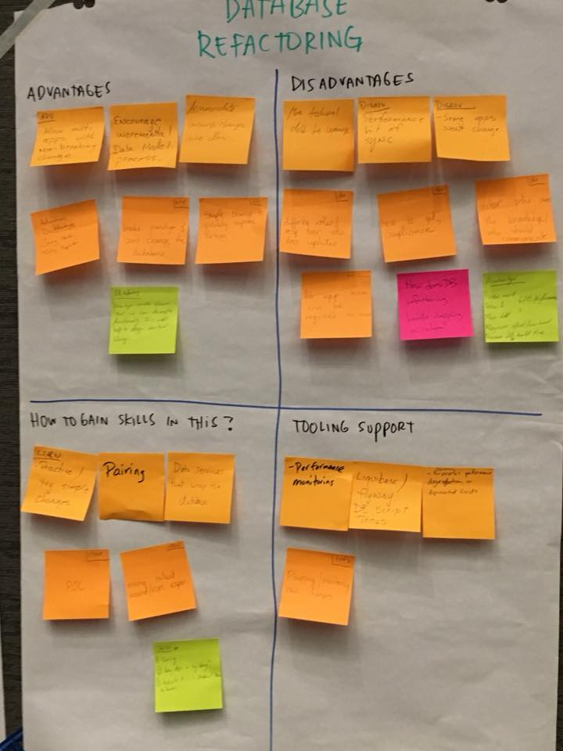
3) Tools
Wisdom of Crowd

Slide 31
Summary
Tech/Process両側面で、心理的安全性をベースにbusinessにインパクトを！

Slide 32
自動テスト＝心理的安全性
（参考）Modern Agile
ここ！

Slide 33
My Motivation
Need to LINE Corp.
・Engineering + Scale
・MVP + Portfolio Management
・Money as Enterprise Metrics
・Projects Are Evil
・Latest Trends
・Mob Programming

Slide 34
1. Summary of Agile2018
2. Three Big Trends
3. Focus More on Outcome
4. Other Topics
5. Conclusion

Slide 35
Radical Change for Testers
Developer Testing
-> Testers will disappear

Slide 36
Testing & Quality
大概のことは既にやっている！
Developer Testing
Code Review by Testers
Facilitation
BDD

Slide 37
1. Summary of Agile2018
2. Three Big Trends
3. Focus More on Outcome
4. Other Topics
5. Conclusion

Slide 38
これ
1. Moving toward business clearly
Development -> QA/PDM -> Company-wide
2. Utilize technologies for
outcome/value
tools for trial & error
3. Scaling?

Slide 39
Summary
Technology
+
Process
=
Improve Business

